Slide 2
Recognise
The first step in seeking help is RECOGNISING when we need to seek help.

Slide 3
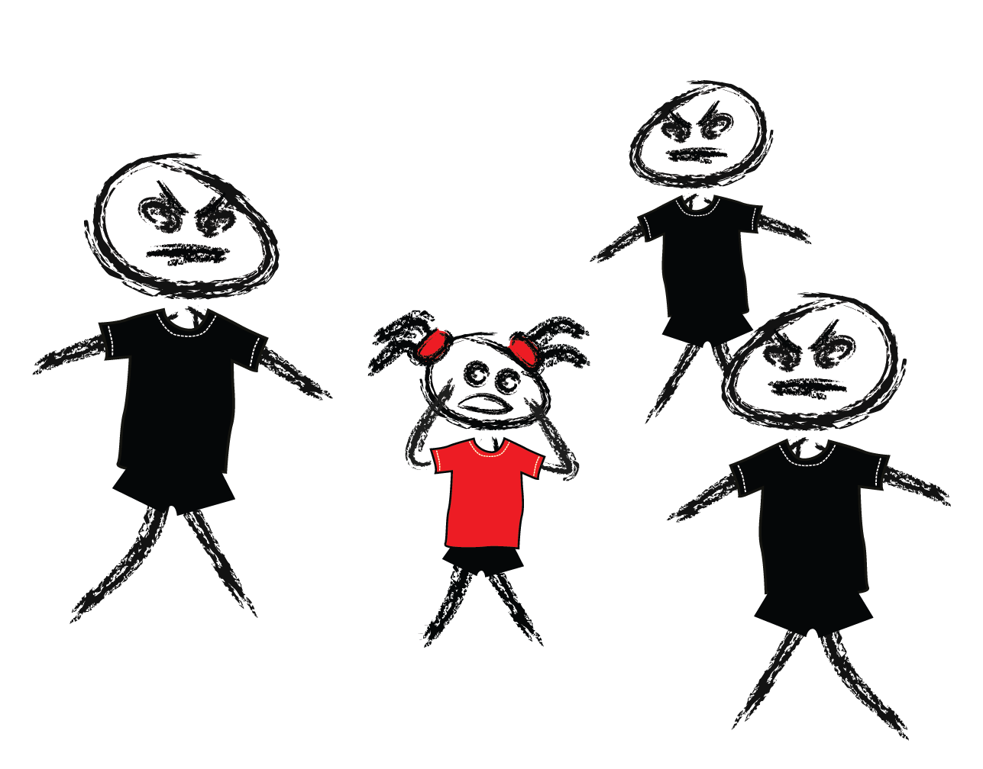
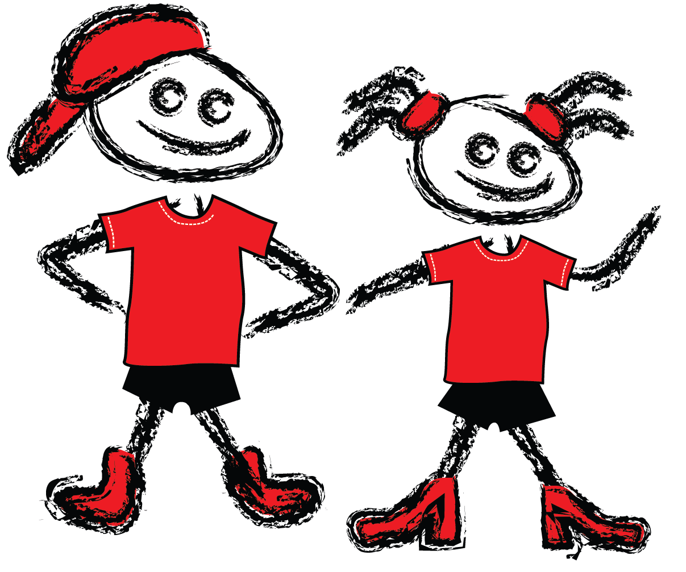
Recognise
safe
unsafe

Slide 4
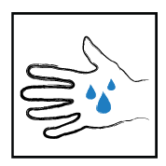
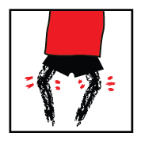
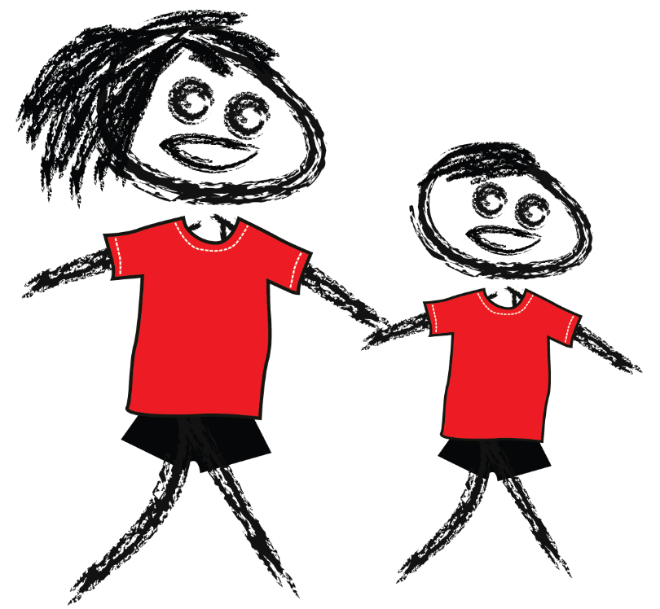
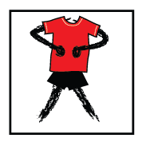
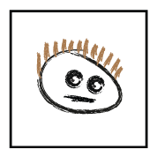
Recognise
body clues
help seeking

Slide 5
Discussion
1. What are some situations where children might need to seek help from an adult?
2. What are body clues?
3. Are there any situations where a child may not notice their body clues?
4. Why do you think some children may choose to ignore their body clues?

Slide 6
Discussion
What are body clues?
When might children not notice body clues?
When might children not be able to react to their body clues?
When might children choose not to react to their body clues?
How can a person tell if someone else is feeling unsafe?

Slide 7
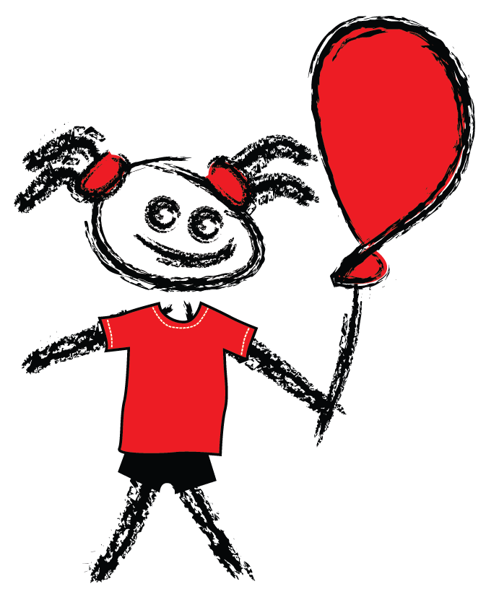
ReACTION
Lei

Slide 8
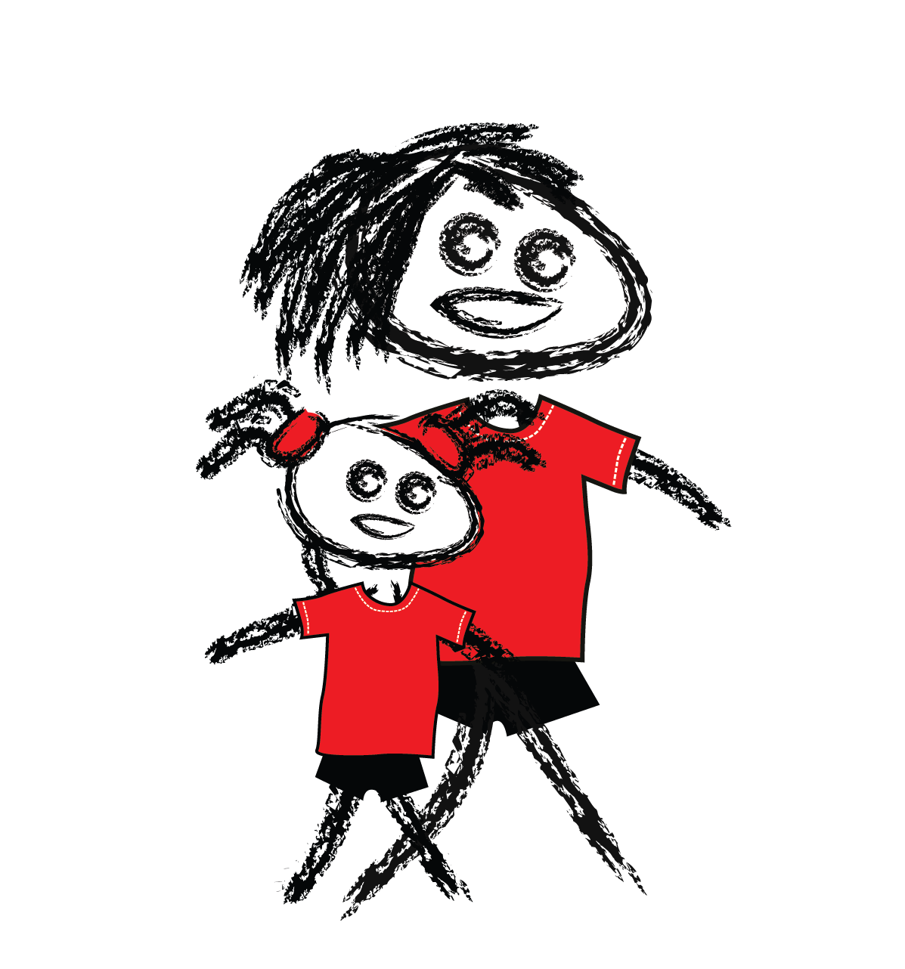
ReACTION
Lei

Slide 9
Situation 1
Situation 2
Situation 3

Slide 10
Situation 4
Situation 5
Situation 6

Slide 11
Situation 7
Situation 8
Situation 9

Slide 12
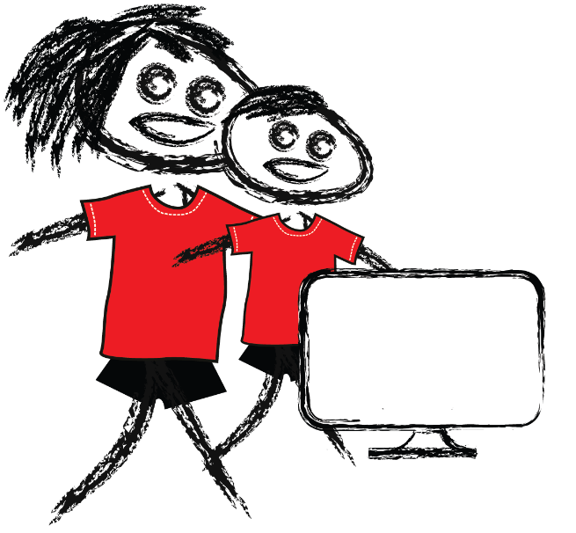
Report!
There are organisations that exist to provide extra support to kids and their safety helpers when they need help solving a problem.
Charlie and his mum are wanting to find a family technology agreement to use. They search online and find the Daniel Morcombe Foundation Website, which has a family technology agreement. Family Technology Agreement

Slide 13
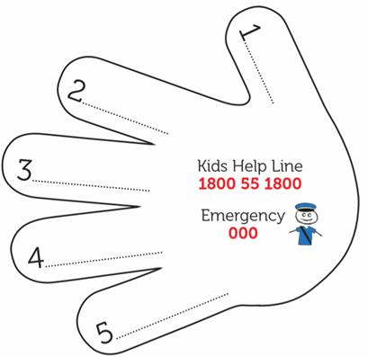
My safety network Activity
1. List your safety helpers. They must be adults and should include someone who lives at home, males and females, as well as people who live outside the home.
Suggestions: Mum, Dad, Carer, Grandparent, Uncle, Teacher, Principal, Friend of Mum or Dad, Police
2. Colour in and cut out your hand.
3. Take home and show the adults on your list.

Slide 14
Where can kids find help?
Support service | How do kids contact them? | What can they help with? | When are they the best support to contact?
eSafety Commissioner | Kids | eSafety Commissioner | Online bullying Finding information about things that worry kids online. | eSafety can give kids help and advice if they are being bullied online. They can also help take down any embarrassing material.

Slide 15
Thank you!
DanielMorcombe.com.au

